Slide 1

Chinook Music store Analysis
By,
Sakthi Ganesh P

Slide 2
Agenda
Problem Statement
Dataset Description
Objective key metrics and visualizations
Conclusion

Slide 3
Problem Statement
You are hired as a data analyst at Chinook, and your objective is to analyze music record sales data to gain insights and make recommendations for the company's strategy in the physical music market.

Slide 4
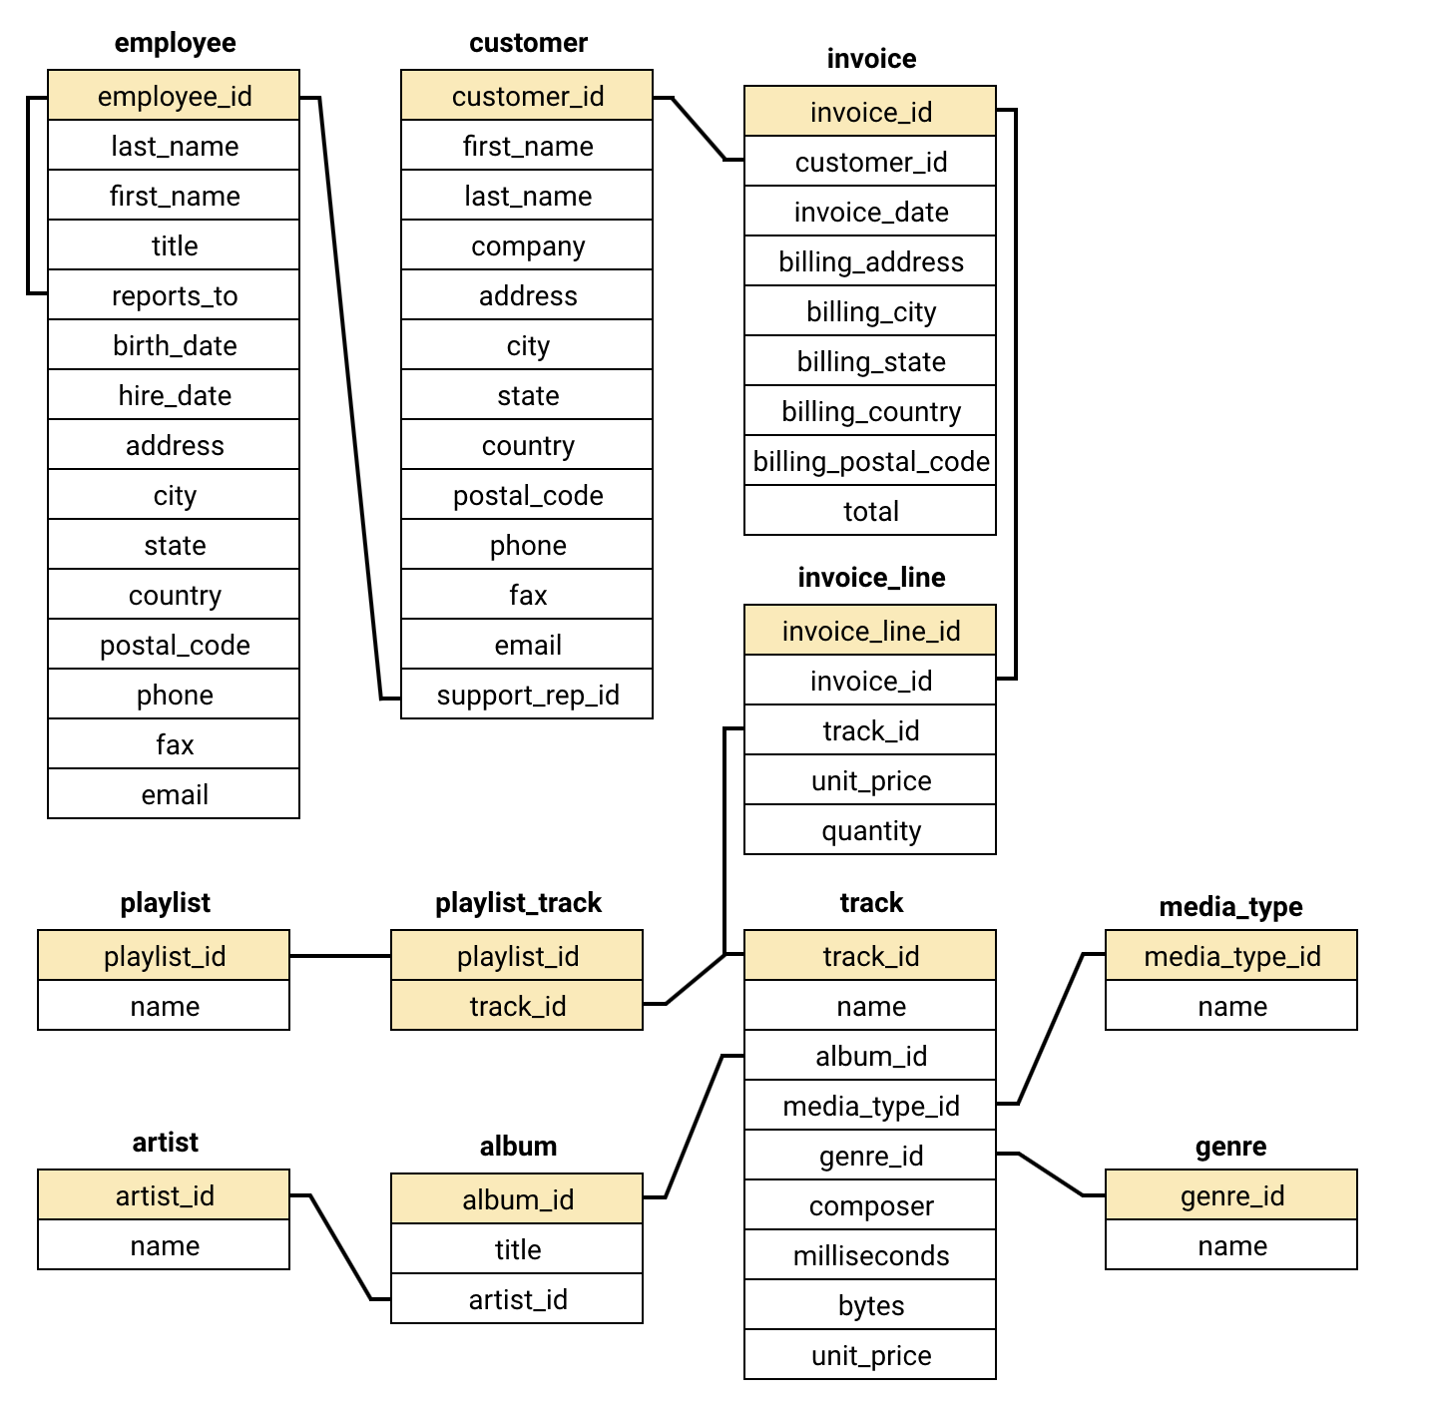

Database Schema

Slide 5

Dataset Description
customer:
customer_id: Unique identifier assigned to each customer.
first_name: The given name or first name of a customer.
last_name: The surname or family name of a customer.
company: The name of the company associated with a customer.
address: The street address of a customer's location.
city: The city where a customer is located.
state: The state or province where a customer is located.
country: The country where a customer is located.
postal_code: The postal or zip code of a customer's address.
phone: The phone number of a customer.
fax: The fax number associated with a customer.
email: The email address of a customer.
support_rep_id: The employee ID of the support representative assigned to a customer.
invoice:
invoice_id: Unique identifier assigned to each invoice.
customer_id: The customer ID associated with the invoice.
invoice_date: The date when the invoice was generated or issued.
billing_address: The street address used for billing purposes.
billing_city: The city used for billing purposes.
billing_state: The state or province used for billing purposes.
billing_country: The country used for billing purposes.
billing_postal_code: The postal or zip code used for billing purposes.
total: The total amount due on the invoice.
invoice_line:
invoice_line_id: Unique identifier assigned to each line item on an invoice.
invoice_id: The invoice ID to which the line item belongs.
track_id: The ID of the track or product included in the line item.
unit_price: The price per unit for the line item.
quantity: The quantity of units for the line item.
playlist:
playlist_id: Unique identifier assigned to each playlist.
name: The name or title of the playlist.
playlist_track:
playlist_id: The ID of the playlist to which the track belongs.
track_id: The ID of the track included in the playlist.
track:
track_id: Unique identifier assigned to each track or song.
name: The title or name of the track.
album_id: The ID of the album to which the track belongs.
media_type_id: The ID of the media type associated with the track.
genre_id: The ID of the genre associated with the track.
composer: The name of the composer or artist who composed the track.
milliseconds: The duration of the track in milliseconds.
bytes: The file size of the track in bytes.
unit_price: The price per unit for the track.

Slide 6
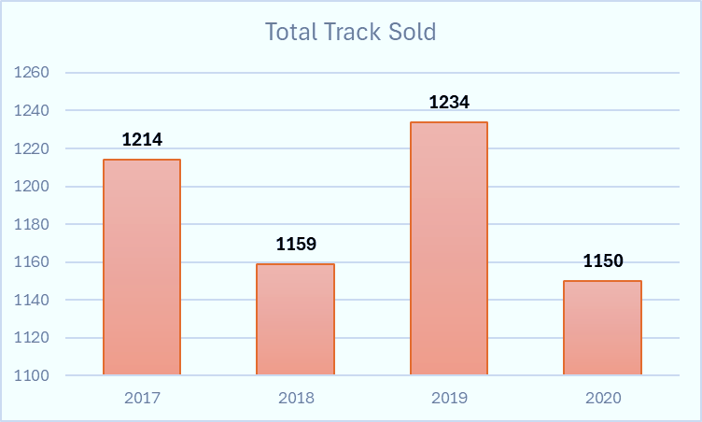
Yearly track sales analysis
Peak Sales in 2019: Track sales peaked at 1,234, likely driven by heightened demand or successful promotional efforts.
Stable Sales Trend: Sales demonstrated consistency over the years, with a minor decline to 1,150 in 2020, reflecting sustained customer engagement.

Slide 7
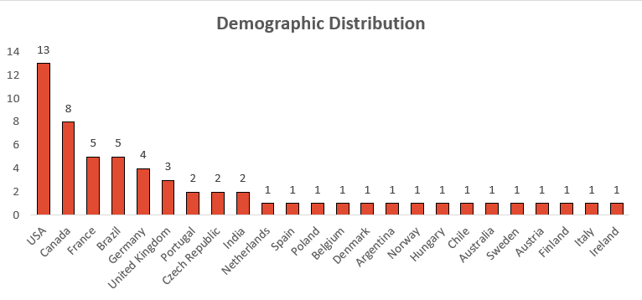
Demographic Distribution
Leading Customer Base: The United States has the largest number of customers, followed by Canada, France, Brazil, and Germany.
Emerging Markets: Countries such as Portugal, India, Spain, Belgium, Argentina, and Norway have a limited customer base, with only 1 or 2 customers in each.

Slide 8
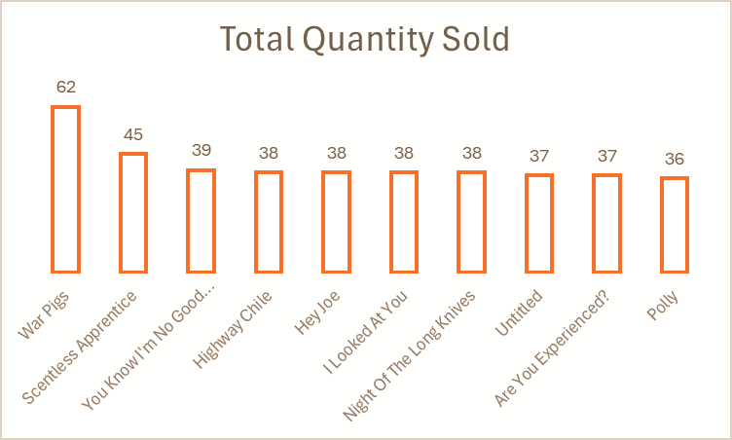
Global Top-selling Tracks
Top Track: "War Pigs" stands out with 247 sales, showcasing its widespread global popularity.
Strong Demand for Hits: Tracks like "Hey Joe," "Are You Experienced?," and "Third Stone From The Sun" also perform exceptionally well, with sales ranging from 149 to 177, reflecting a robust and resonant collection of music.

Slide 9
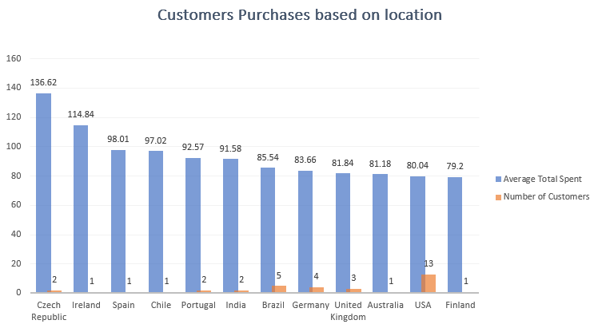
Customer purchases based on location
Czech Republic has the highest average spending per customer at 136.62.
USA has the most customers (13) but a lower average spending per customer at 80.04.
Ireland, Spain, Chile, Portugal, and Australia each have only one customer with varying spending.
Brazil has a relatively higher number of customers (5) with an average spending of 85.54.

Slide 10
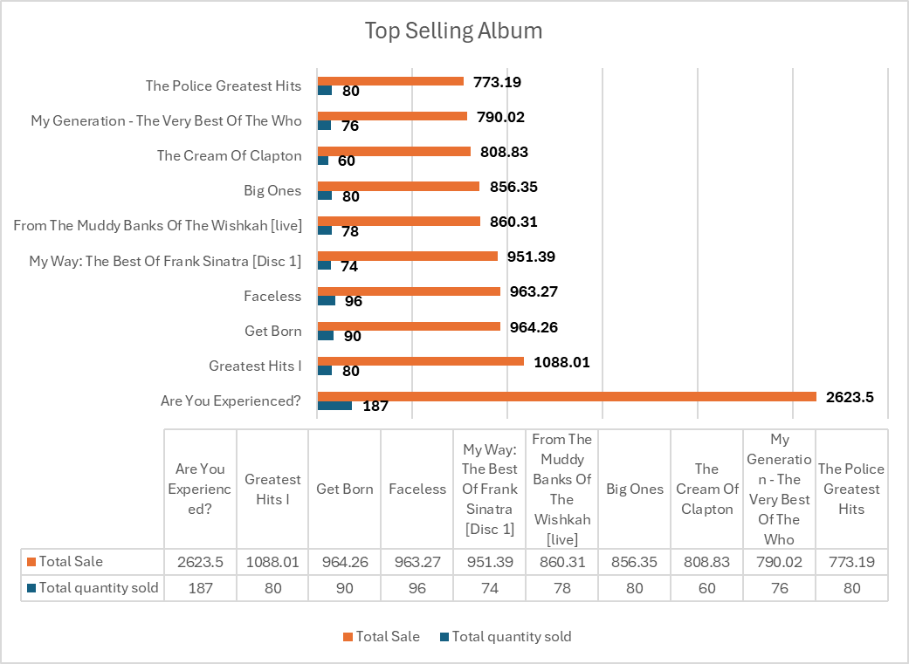
Top-Selling Albums
Outstanding Sales for "Are You Experienced?": With a total of 2,624 sales, Are You Experienced? ranks as the best-selling album, highlighting its lasting appeal.
Significant Interest in Greatest Hits: Albums such as Greatest Hits I by Queen (1,088 sales) and The Police Greatest Hits (773 sales) demonstrate a strong preference for compilations of iconic tracks.

Slide 11
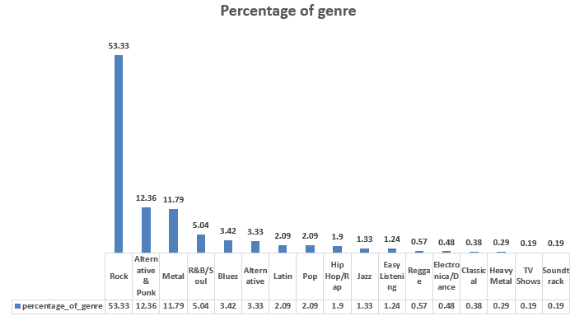
Genre popularity analysis
Rock's Prominence: Rock leads the charts, representing 53.33% of total sales, underscoring its widespread popularity across a diverse audience.
Varied Preferences in Top Genres: After Rock, genres such as Alternative & Punk (12.36%) and Metal (11.79%) also enjoy considerable interest, while R&B/Soul (5.04%) and Blues (3.42%) appeal to more specialized listener groups.

Slide 12
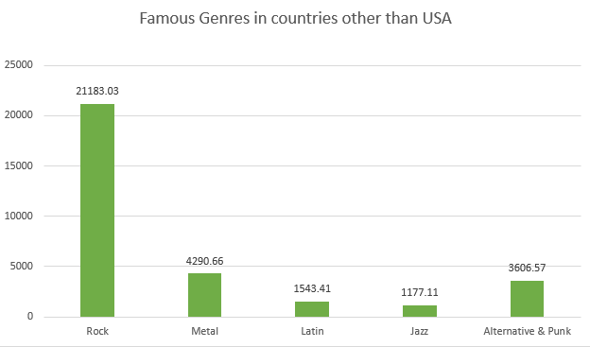
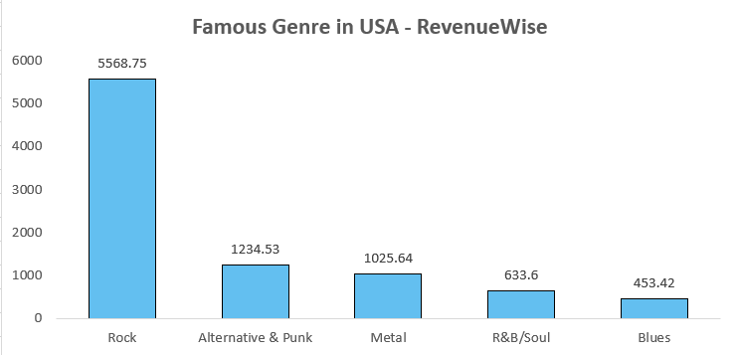
Comparing USA music preference with global trends
There are notable similarities in the popularity of music genres in the USA compared to other countries.
In both cases, Rock emerges as the most popular genre. However, the second and third rankings differ slightly outside the USA, where Metal takes the second spot, followed by Alternative & Punk in third place.

Slide 13
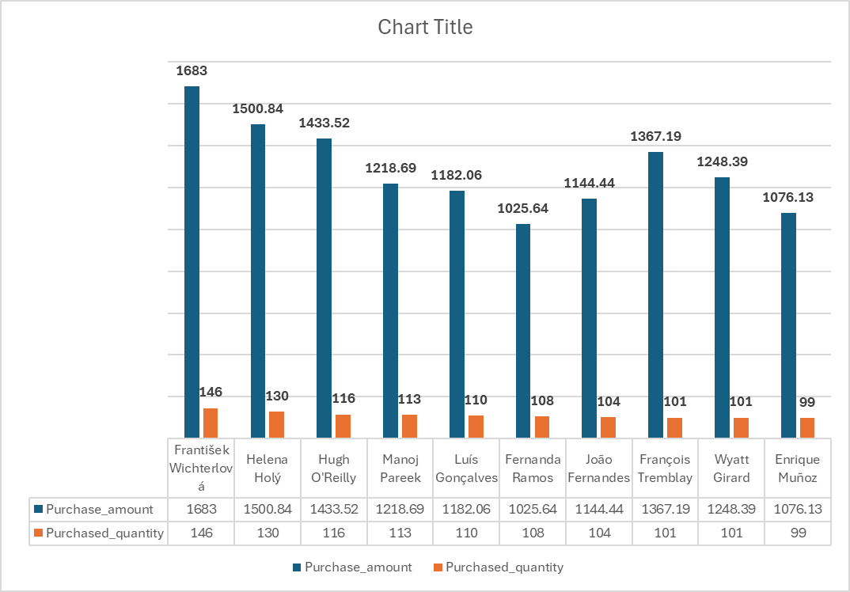
Top 10 customers with highest revenues
The visual showcases the top 10 customers worldwide in terms of revenue.
The blue bars represent each customer's total spending, while the red bars indicate the number of tracks purchased.
This information provides valuable insights into customer purchasing patterns.

Slide 14
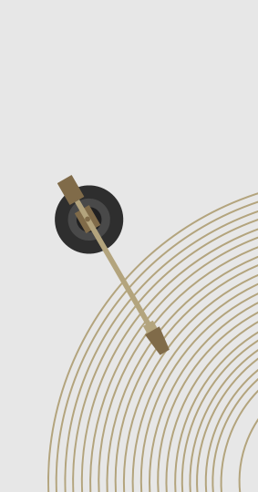
Key strategies to maximize music sales
Record-Breaking Sales Year: Track sales peaked in 2019 with 1,234 units sold, suggesting that successful marketing tactics from that year could be adapted for future campaigns to stimulate demand.
Rock’s Popularity: Rock, representing over 53% of total sales, remains a dominant genre. Companies should prioritize promoting rock artists and albums to leverage their broad appeal.
Top Artist Spotlight: Jimi Hendrix, the leading artist with 2,624 sales, presents opportunities for re-releases, special editions, or exclusive content to further boost revenue.
Regional Market Dynamics: The USA, with the highest sales (10,406), followed by Canada and Brazil, underscores the need for region-specific marketing strategies. Expanding efforts into European markets could unlock additional growth potential.

Slide 15
Conclusion
In conclusion, the analysis presented offers valuable insights into customer purchasing behaviors and preferences, considering both geographic location and genre popularity, which can guide targeted strategies.
By identifying high-revenue customers and monitoring their purchase frequency, companies can create effective strategies to re-engage inactive customers and reduce churn in at-risk segments.
The data also underscores the strong appeal of genres like Rock across different regions, presenting opportunities for tailored cross-selling and upselling based on customer and regional preferences.
Additionally, examining the differing purchasing patterns of long-term and new customers highlights potential for loyalty programs and personalized offers to enhance retention and improve overall customer satisfaction.

